Slide 1
POLYNOMIAL FUNCTIONS
Computer Assisted Mathematics - Seminar
ROSALIE FRANZ, NOÉLIE WEIMER

Slide 2
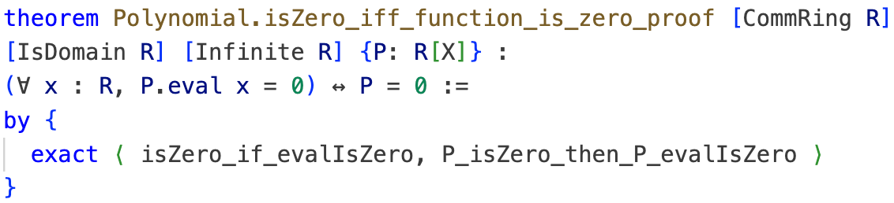

Main Theorem:
ROSALIE FRANZ, NOÉLIE WEIMER

Slide 3
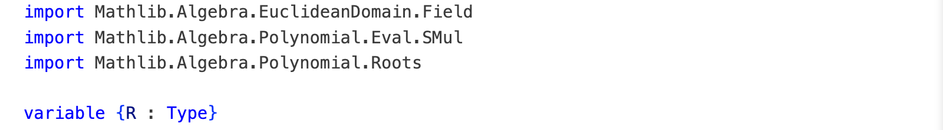

Import and context
ROSALIE FRANZ, NOÉLIE WEIMER

Slide 4
Usefull functions:
Evaluation of polynomials:
Constant polynomials:
Definition of a root
ROSALIE FRANZ, NOÉLIE WEIMER

Slide 5
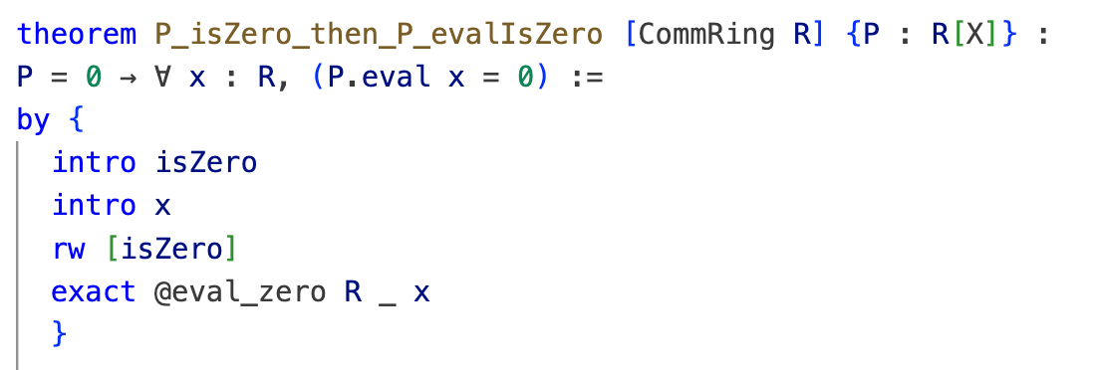
Forward direction of main theorem
ROSALIE FRANZ, NOÉLIE WEIMER

Slide 6
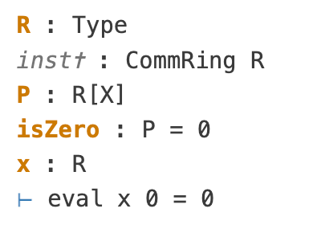
Forward direction: proof (1)
ROSALIE FRANZ, NOÉLIE WEIMER

Slide 7
Forward direction: proof (2)
ROSALIE FRANZ, NOÉLIE WEIMER

Slide 8
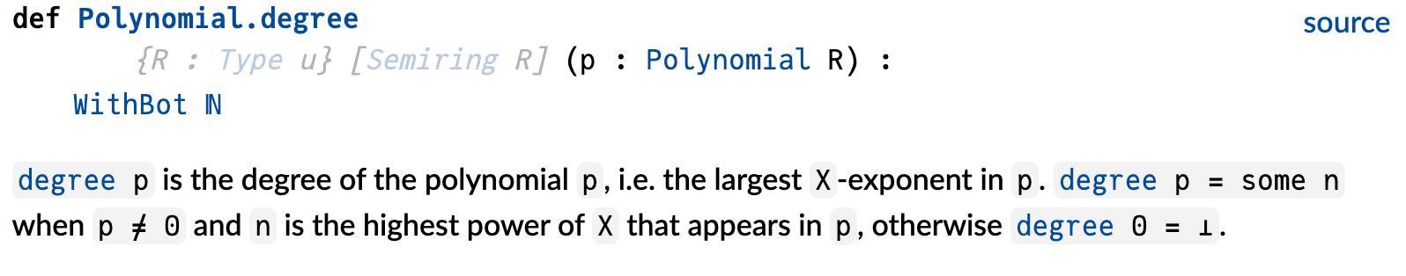
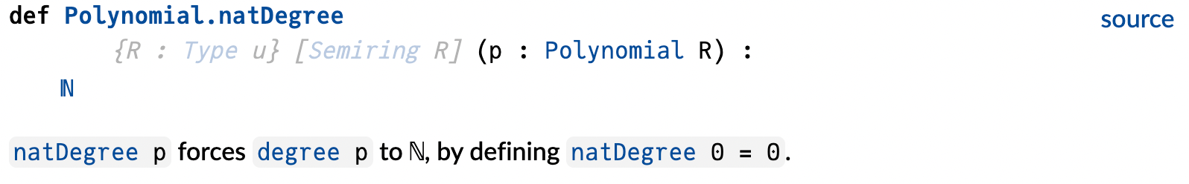
Definition of “degree” and “natDegree”:
ROSALIE FRANZ, NOÉLIE WEIMER

Slide 9
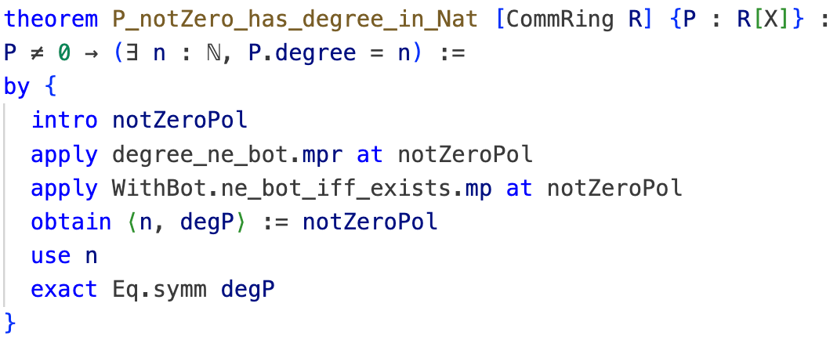
Lemma 1: P_notZero_has_degree_in_Nat (1)
ROSALIE FRANZ, NOÉLIE WEIMER

Slide 10
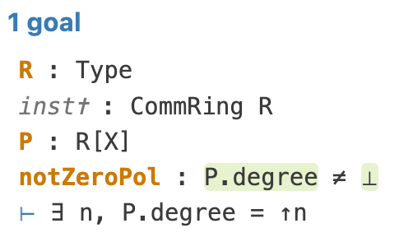
Lemma 1: proof (2)
ROSALIE FRANZ, NOÉLIE WEIMER

Slide 11
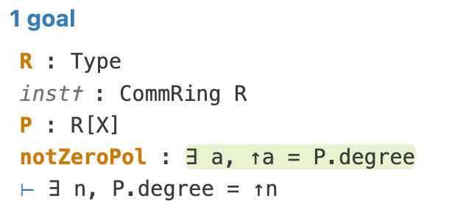
Lemma 1: proof (3)
ROSALIE FRANZ, NOÉLIE WEIMER

Slide 12
Lemma 1: proof (4)
ROSALIE FRANZ, NOÉLIE WEIMER

Slide 13
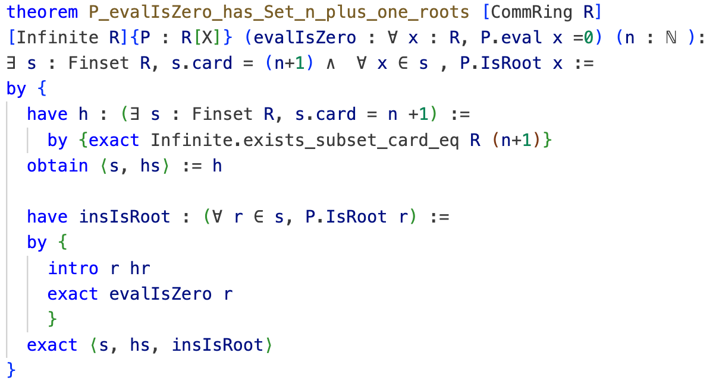
Lemma 2: P_evalIsZero_has_Set_n_plus_one_roots
ROSALIE FRANZ, NOÉLIE WEIMER

Slide 14
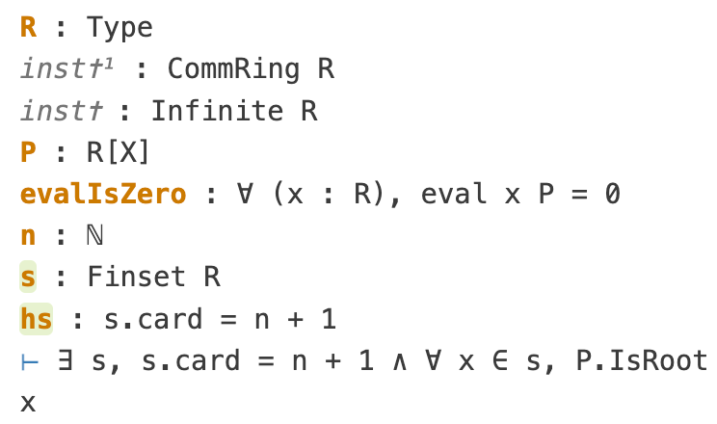
Lemma 2: proof (1)
Infinite set contains finite set of any cardinality
ROSALIE FRANZ, NOÉLIE WEIMER

Slide 15
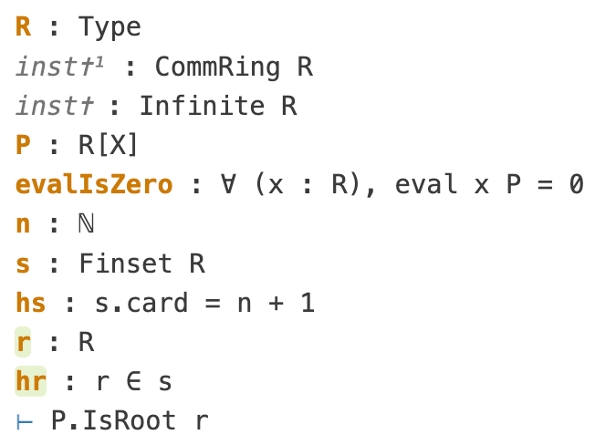
Lemma 2: proof (2)
ROSALIE FRANZ, NOÉLIE WEIMER

Slide 16
Lemma 2: proof (3)
ROSALIE FRANZ, NOÉLIE WEIMER

Slide 17
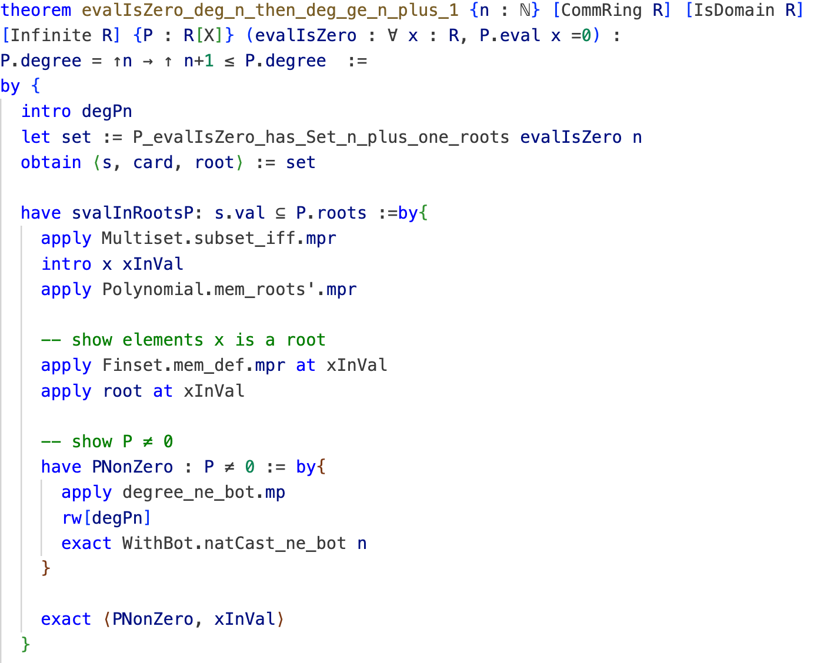
Lemma 3: evalIsZero_deg_n_then_deg_ge_n_plus_one
ROSALIE FRANZ, NOÉLIE WEIMER

Slide 18
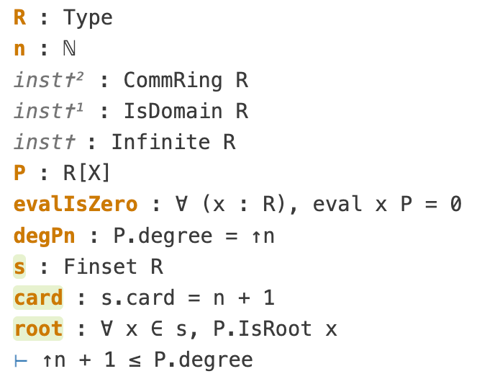
Lemma 3: proof (1)
Use of lemma 2
ROSALIE FRANZ, NOÉLIE WEIMER

Slide 19
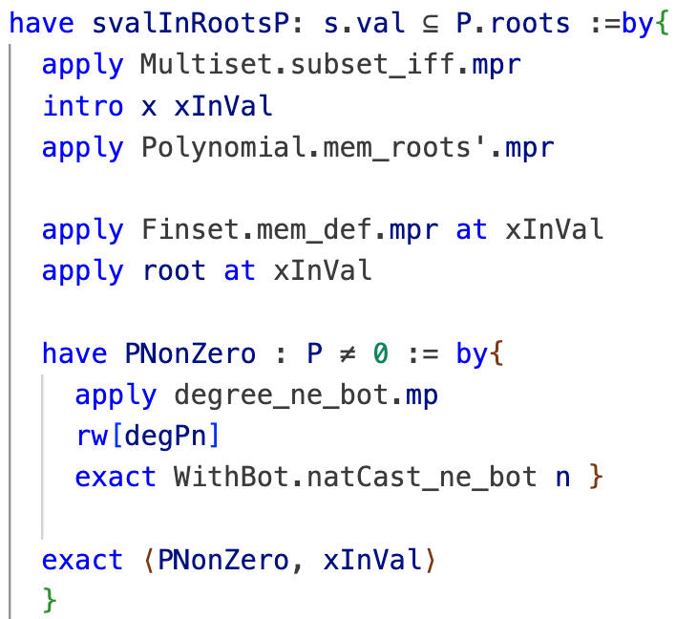
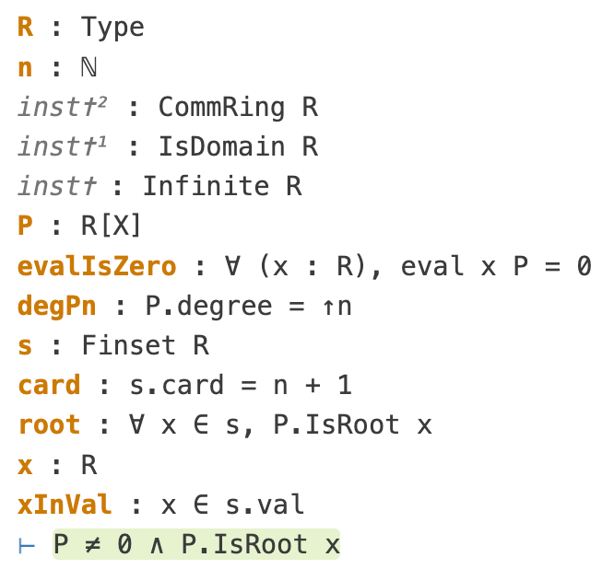
Lemma 3: proof (2)
ROSALIE FRANZ, NOÉLIE WEIMER

Slide 20
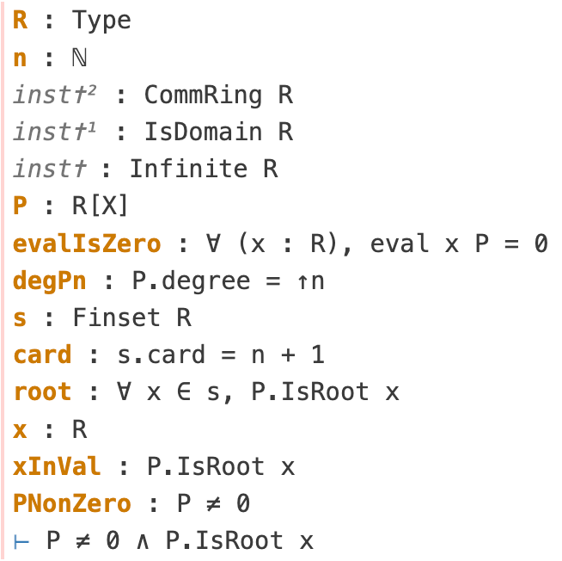
Lemma 3: proof (3)
ROSALIE FRANZ, NOÉLIE WEIMER

Slide 21
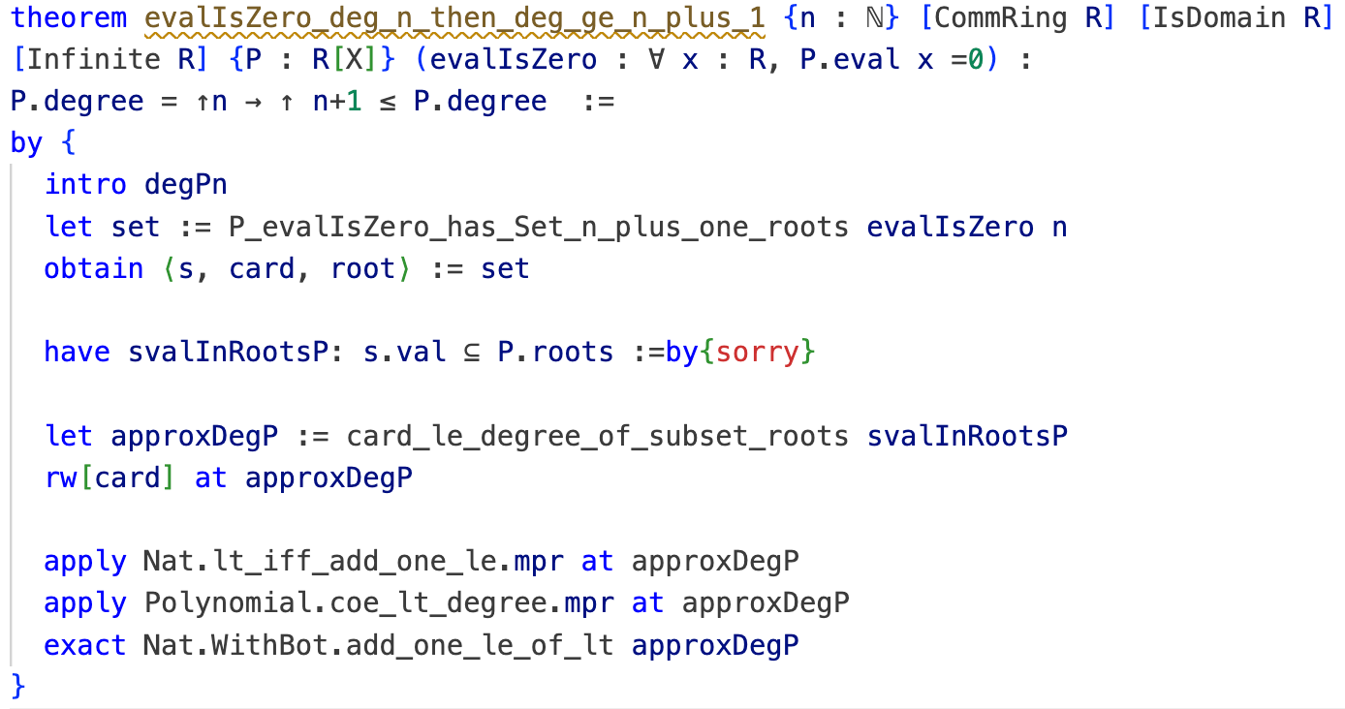
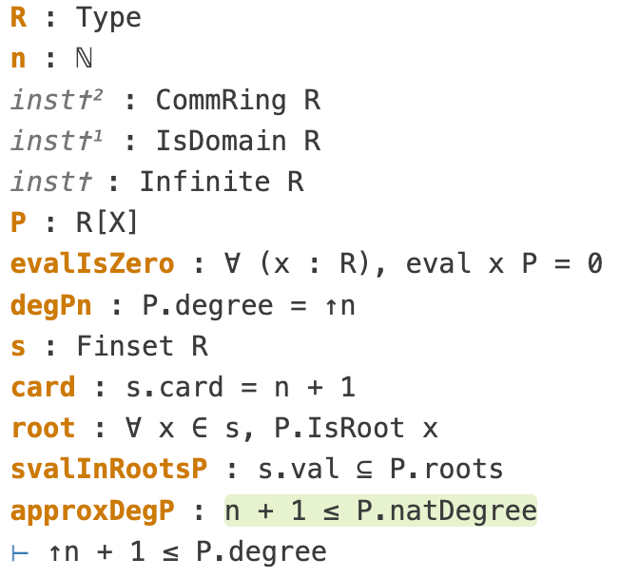
Lemma 3: proof (4)
ROSALIE FRANZ, NOÉLIE WEIMER

Slide 22
Lemma 3: proof (5)
ROSALIE FRANZ, NOÉLIE WEIMER

Slide 23
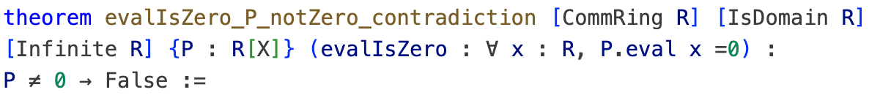
Lemma 4: evalIsZero_P_notZero_contradiction
ROSALIE FRANZ, NOÉLIE WEIMER

Slide 24
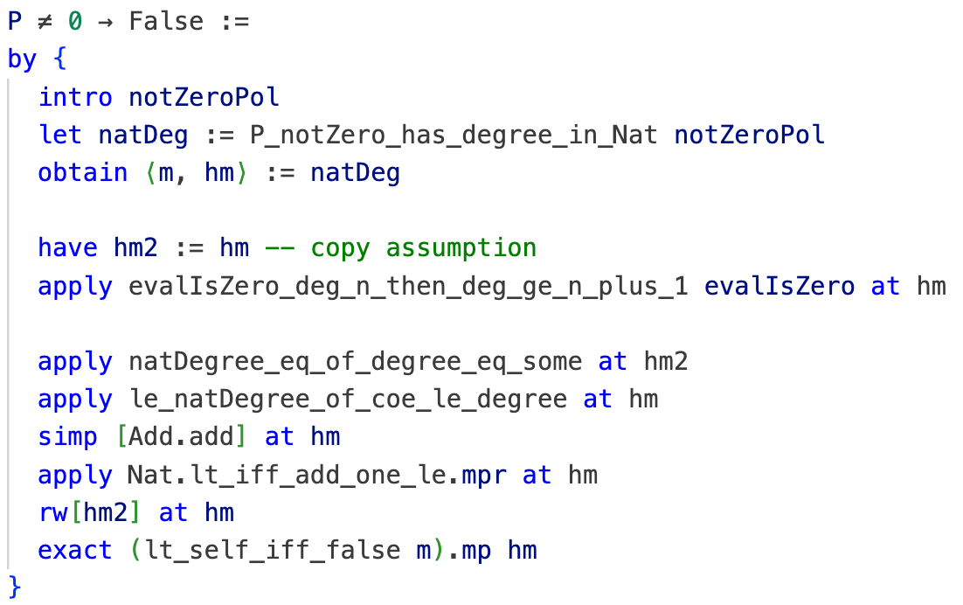
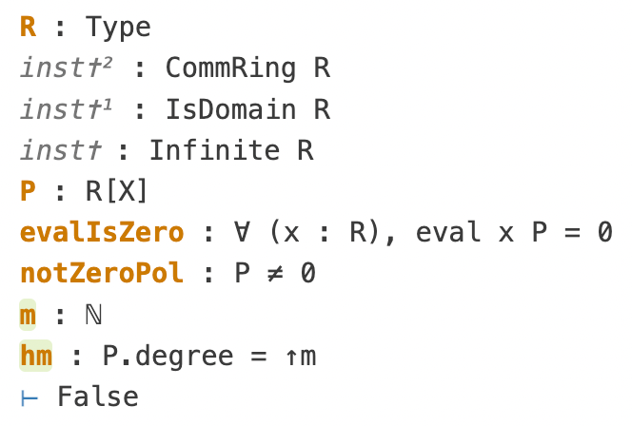
Lemma 4: proof (1)
Use of lemma 1
ROSALIE FRANZ, NOÉLIE WEIMER

Slide 25
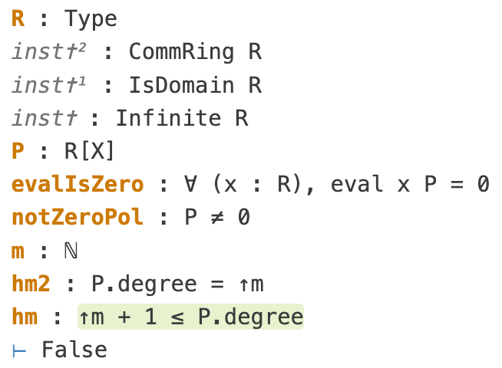
Lemma 4: proof (2)
Use of lemma 3
ROSALIE FRANZ, NOÉLIE WEIMER

Slide 26
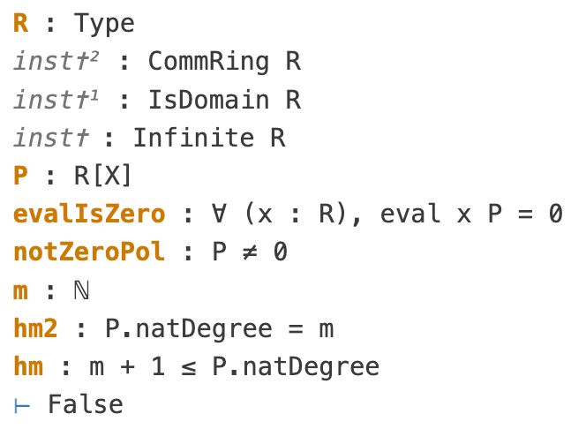
Lemma 4: proof (3)
ROSALIE FRANZ, NOÉLIE WEIMER

Slide 27
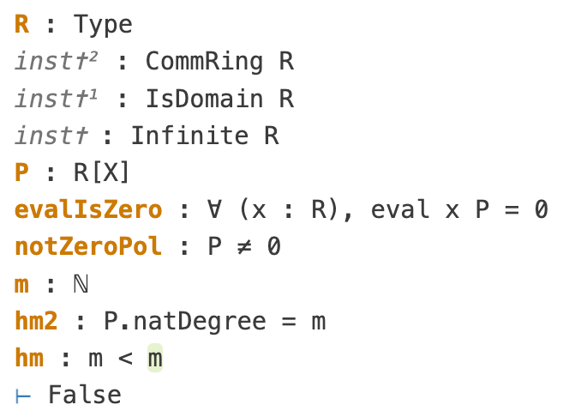
Lemma 4: proof (4)
ROSALIE FRANZ, NOÉLIE WEIMER

Slide 28
Lemma 4: proof (5)
ROSALIE FRANZ, NOÉLIE WEIMER

Slide 29
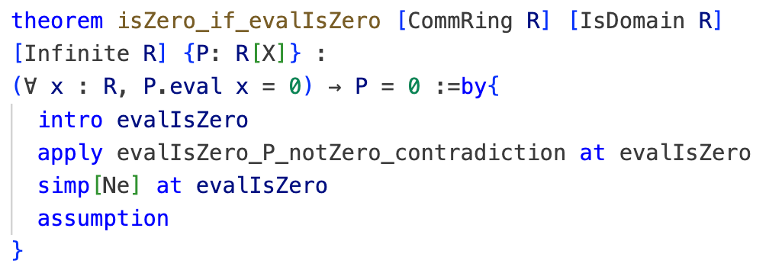
Reverse direction of Main Theorem:
ROSALIE FRANZ, NOÉLIE WEIMER

Slide 30
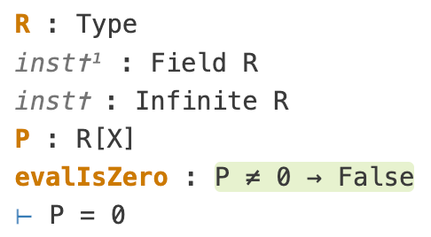
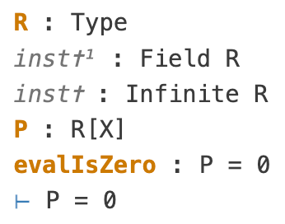
Reverse direction of Main Theorem: proof (1)
Use of lemma 4
ROSALIE FRANZ, NOÉLIE WEIMER

Slide 31
Reverse direction of Main Theorem: proof (2)
ROSALIE FRANZ, NOÉLIE WEIMER

Slide 32
Main Theorem:
ROSALIE FRANZ, NOÉLIE WEIMER

Slide 33


Main Theorem:
ROSALIE FRANZ, NOÉLIE WEIMER

Slide 35
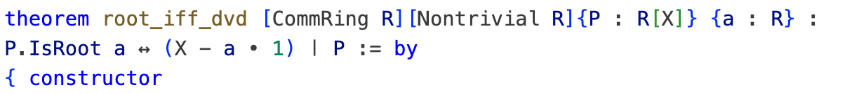
Equivalent characterisation of roots:
ROSALIE FRANZ, NOÉLIE WEIMER

Slide 36
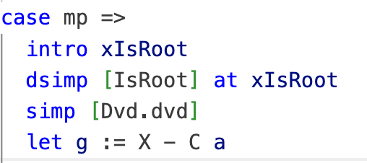
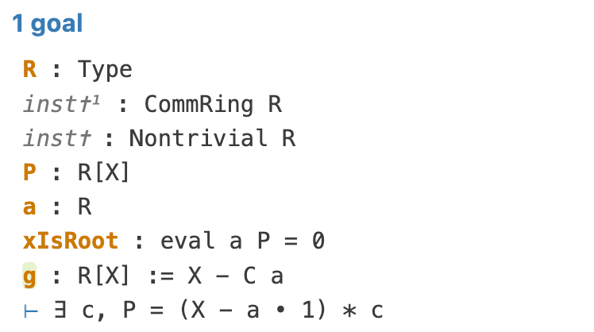
Proof of root_iff_dvd: mp (1)
ROSALIE FRANZ, NOÉLIE WEIMER

Slide 37
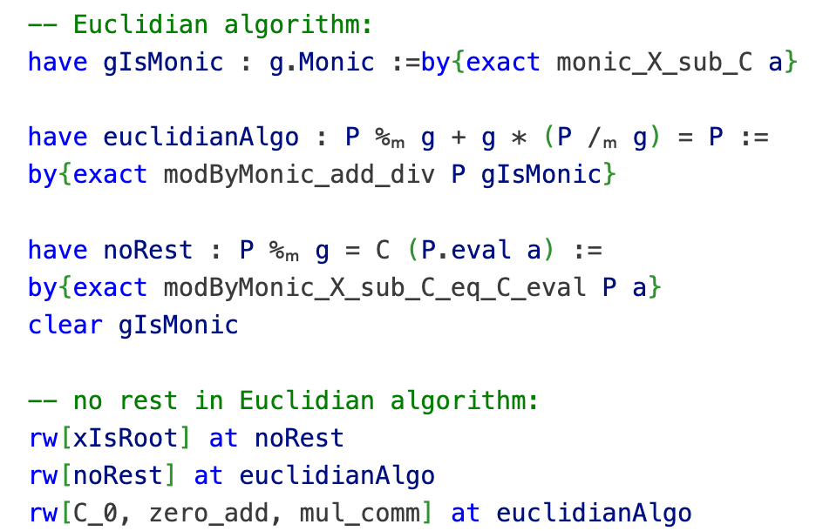
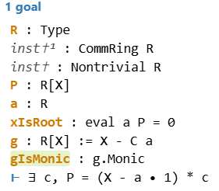
Proof of root_iff_dvd: mp (2)
ROSALIE FRANZ, NOÉLIE WEIMER

Slide 38
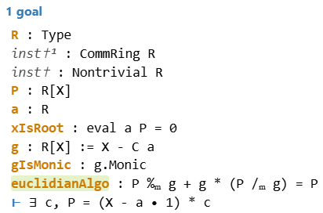
Proof of root_iff_dvd: mp (3)
ROSALIE FRANZ, NOÉLIE WEIMER

Slide 39
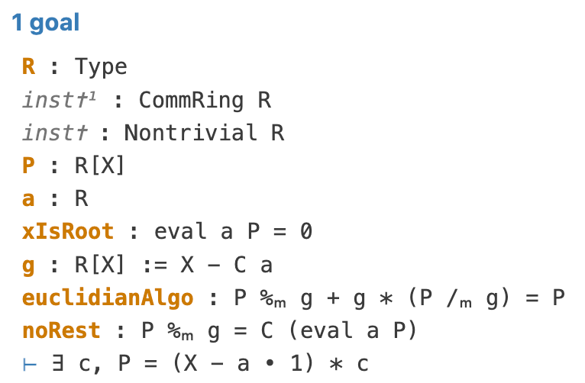
Proof of root_iff_dvd: mp (4)
ROSALIE FRANZ, NOÉLIE WEIMER

Slide 40
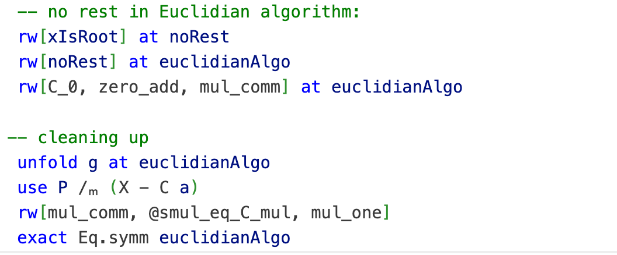
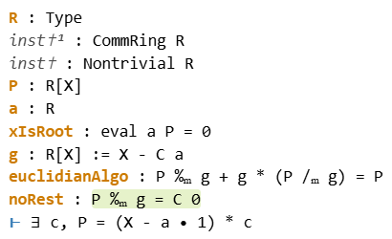
Proof of root_iff_dvd: mp (5)
ROSALIE FRANZ, NOÉLIE WEIMER

Slide 41
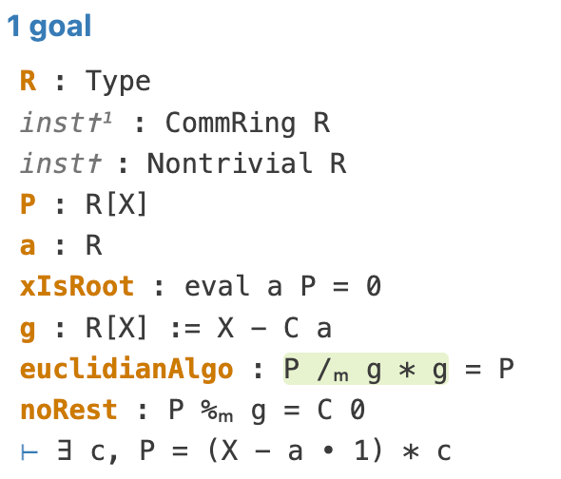
Proof of root_iff_dvd: mp (5)
ROSALIE FRANZ, NOÉLIE WEIMER

Slide 42
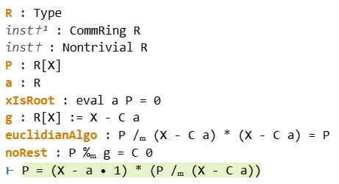

Proof of root_iff_dvd: mp (6)
ROSALIE FRANZ, NOÉLIE WEIMER

Slide 43
Proof of root_iff_dvd: mp (7)
ROSALIE FRANZ, NOÉLIE WEIMER

Slide 44
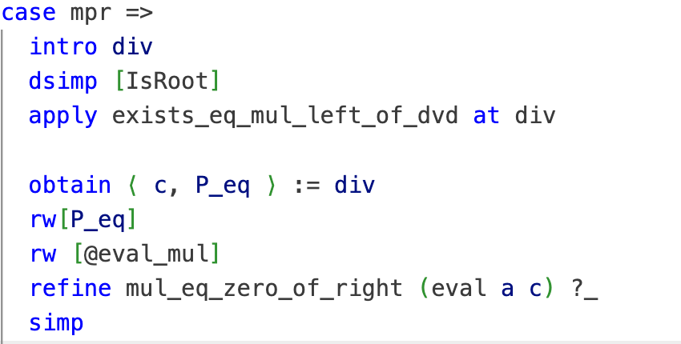
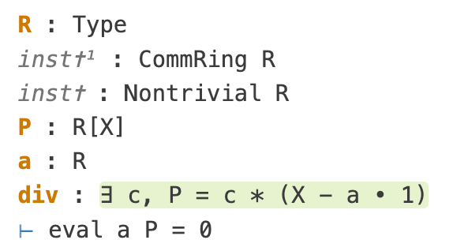
Proof of root_iff_dvd: mpr (1)
ROSALIE FRANZ, NOÉLIE WEIMER

Slide 45
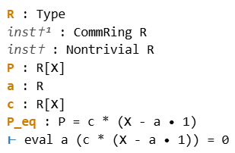
Proof of root_iff_dvd: mpr (2)
ROSALIE FRANZ, NOÉLIE WEIMER

Slide 46
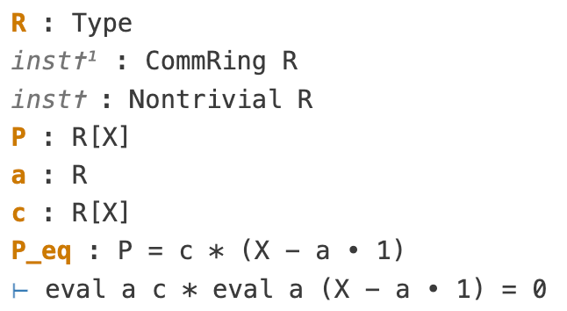
Proof of root_iff_dvd: mpr (3)
ROSALIE FRANZ, NOÉLIE WEIMER

Slide 47
Proof of root_iff_dvd: mpr (4)
ROSALIE FRANZ, NOÉLIE WEIMER

Slide 48
THANK YOU FOR LISTENING
ANY QUESTIONS?
ROSALIE FRANZ, NOÉLIE WEIMER

