Slide 1
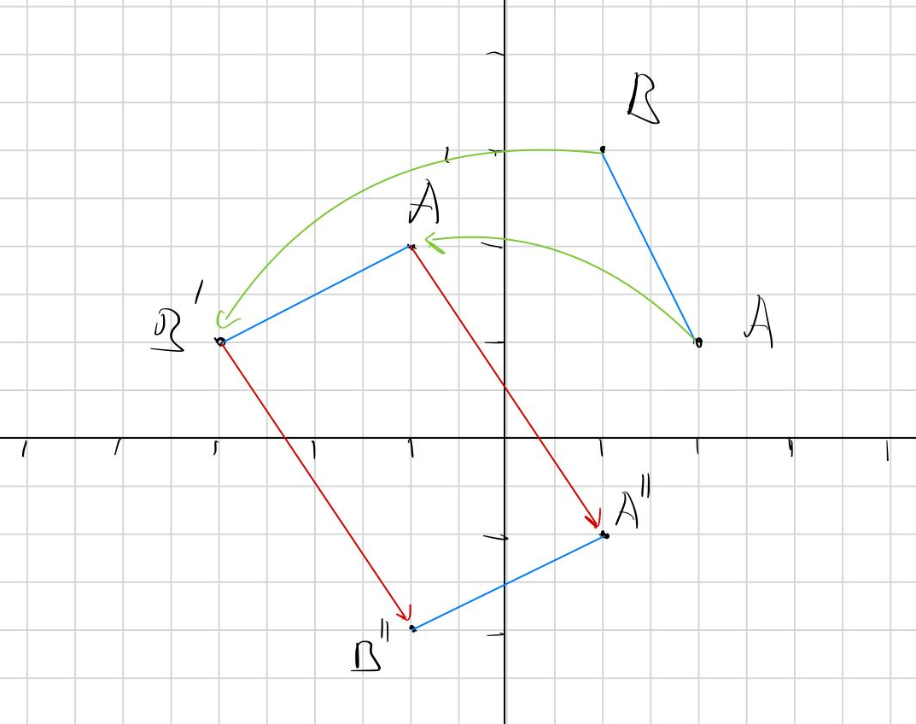
$||$ f(x) – f(y) $||$ = $||$ x - y $||$
Affine Isometries
Computer-assisted mathematics
Youssef Daoudi El Boukhrissi
Jan Kirschbaum

Slide 2
DEFINITION IN LEAN
LEMMA: SUBTRACTING A CONSTANT OF AN AFFINE ISOMETRY YIELDS AN AFFINE ISOMETRY

Slide 3
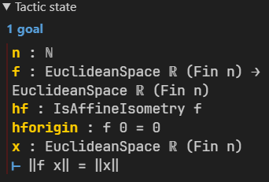
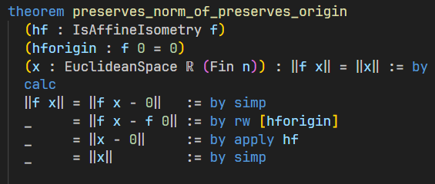
PROOF OF: || f(x) || = || x ||
GOAL

Slide 4
abel: Abelian group axioms
norm_sub_pow_two_real: ‖x - y‖² = ‖x‖² - 2 * <x, y> + ‖y‖²

Slide 5
THEOREM: IF AN AFFINE ISOMETRY PRESERVES THE ORIGIN, IT PRESERVES THE INNERPRODUCT

Slide 6
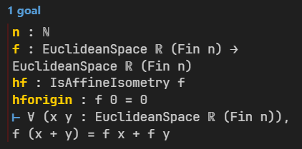
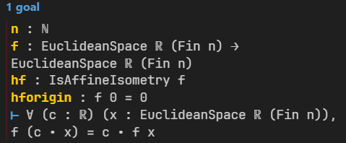
map_add
map_smul

Slide 7
PROOF OF: map_add

Slide 8
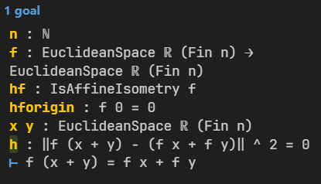
PROOF OF: map_add
GOAL

Slide 9
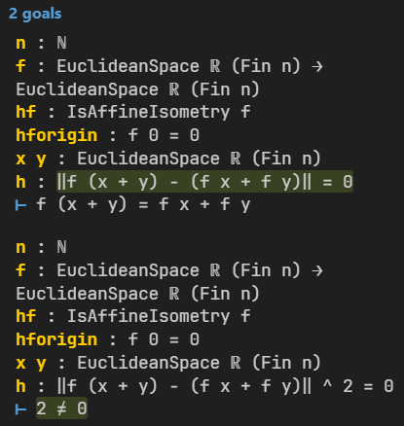
GOAL
PROOF OF: map_add

Slide 10
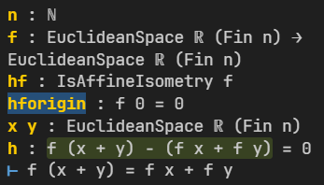
PROOF OF: map_add
GOAL

Slide 11
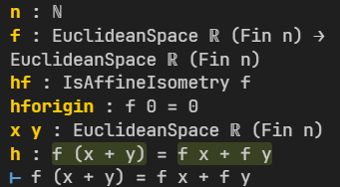
PROOF OF: map_add
GOAL

Slide 12
PROOF OF: map_add
GOAL

Slide 13
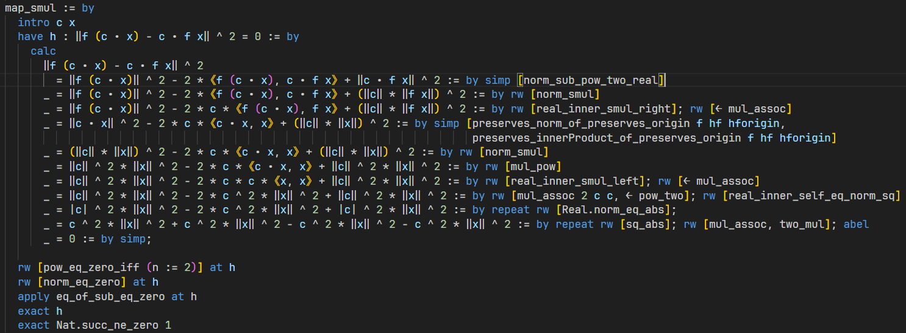
PROOF OF: map_smul

Slide 14
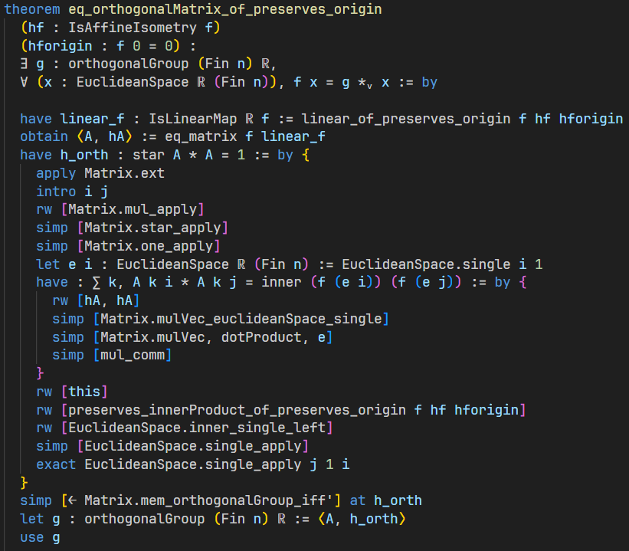
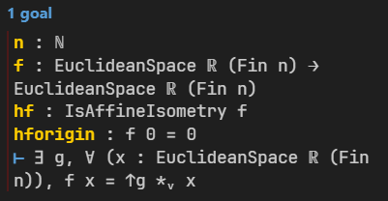
GOAL

Slide 15
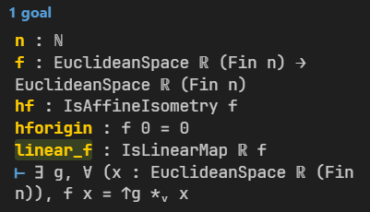
GOAL

Slide 16
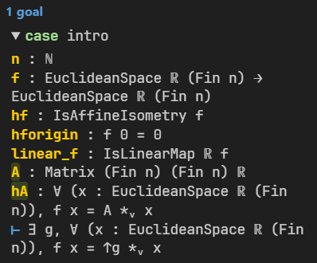
GOAL

Slide 17
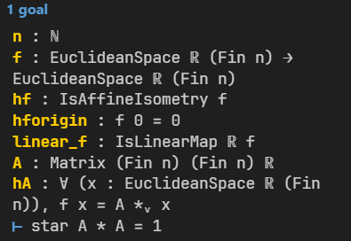
GOAL

Slide 18
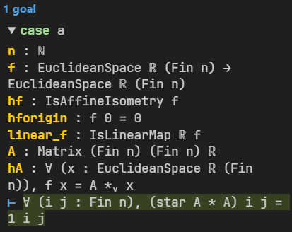
GOAL

Slide 19
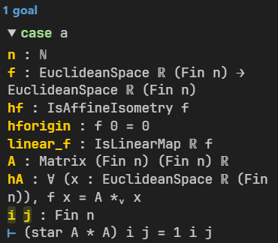
GOAL

Slide 20
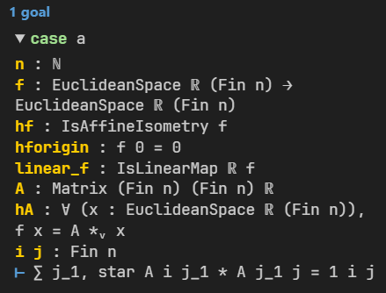
GOAL

Slide 21
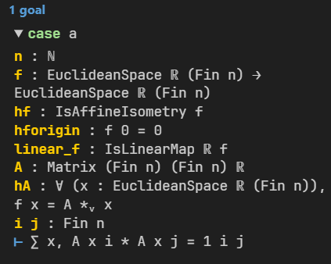
GOAL

Slide 22
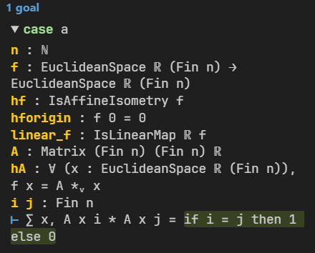
GOAL

Slide 23
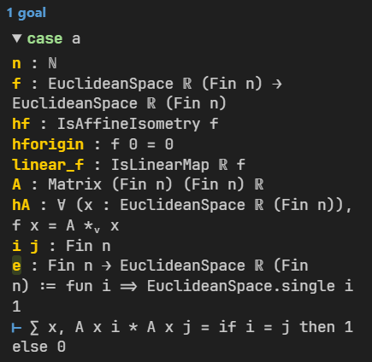
GOAL

Slide 24
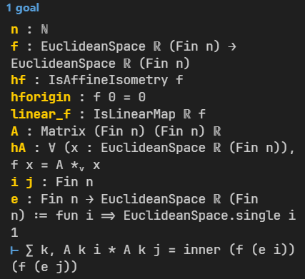
GOAL

Slide 25
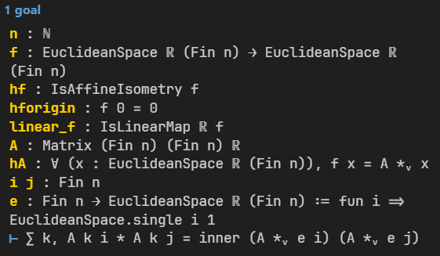
GOAL

Slide 26
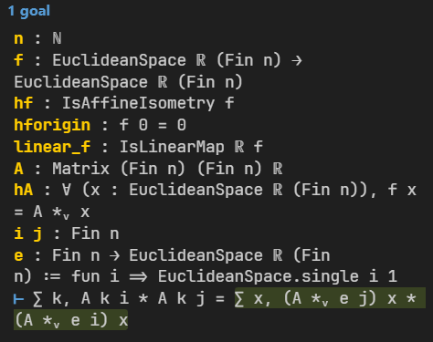
GOAL

Slide 27
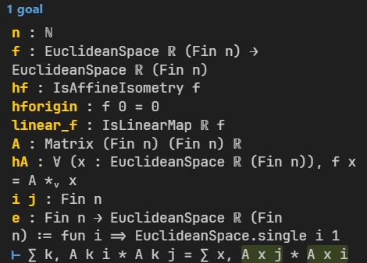
GOAL

Slide 28
GOAL

Slide 29
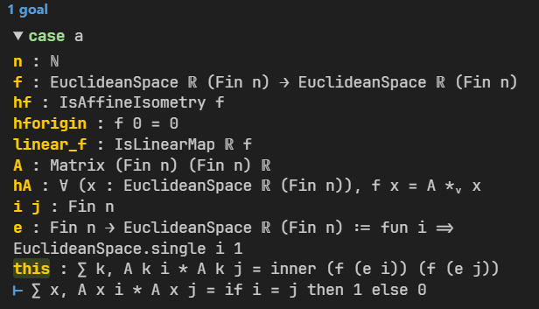
GOAL

Slide 30
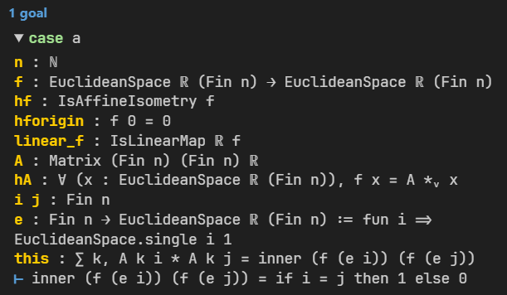
GOAL

Slide 31
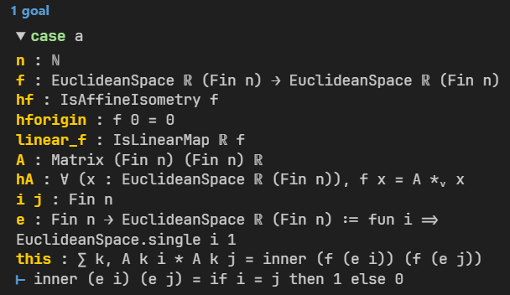
GOAL

Slide 32
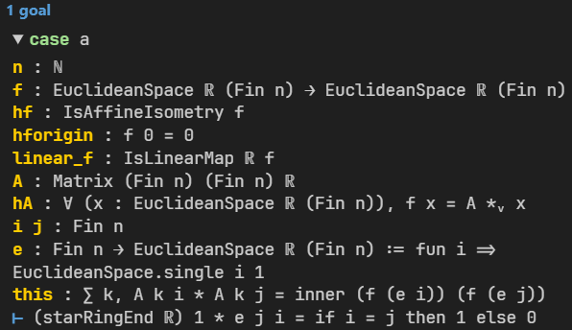
GOAL

Slide 33
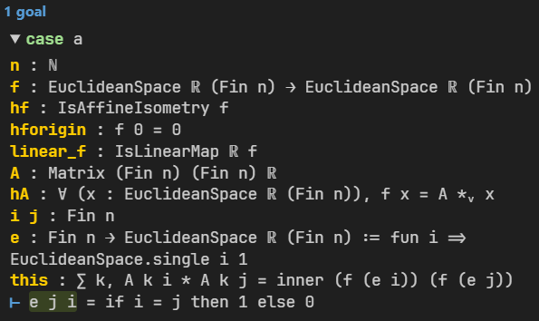
GOAL

Slide 34
GOAL

Slide 35
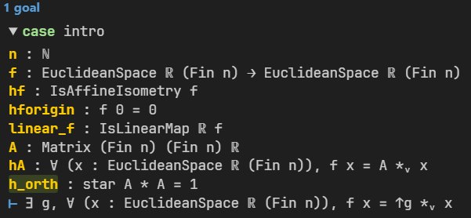
GOAL

Slide 36
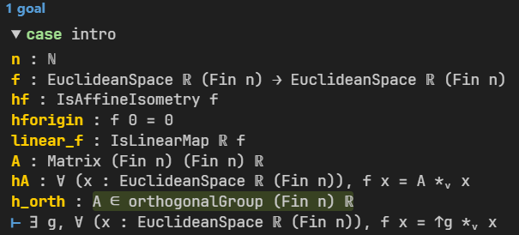
GOAL

Slide 37
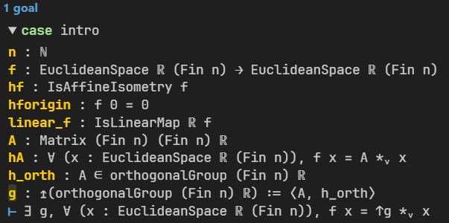
GOAL

Slide 38
GOAL

Slide 39
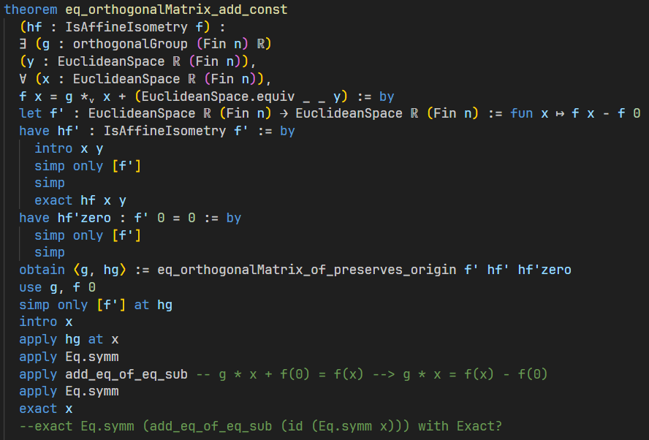
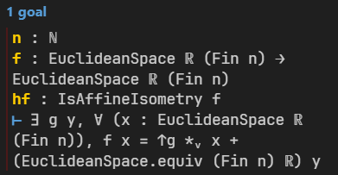
GOAL

Slide 40
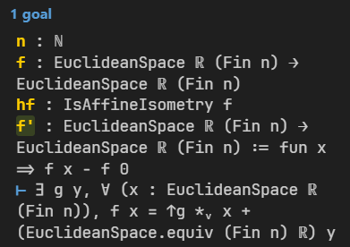
GOAL

Slide 41
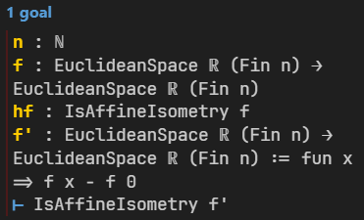
GOAL

Slide 42
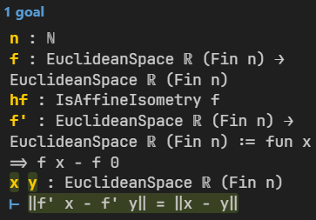
GOAL

Slide 43
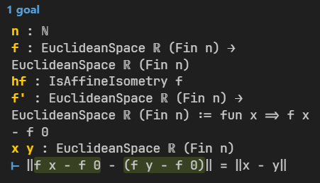
GOAL

Slide 44
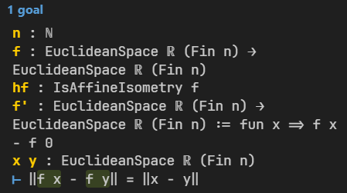
GOAL

Slide 45
GOAL

Slide 46
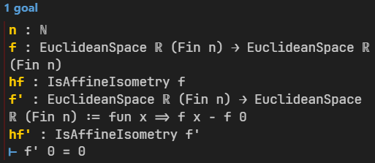
GOAL

Slide 47
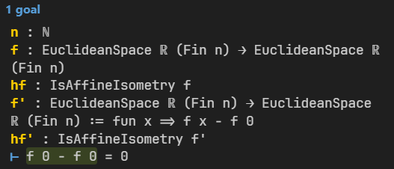
GOAL

Slide 48
GOAL

Slide 49
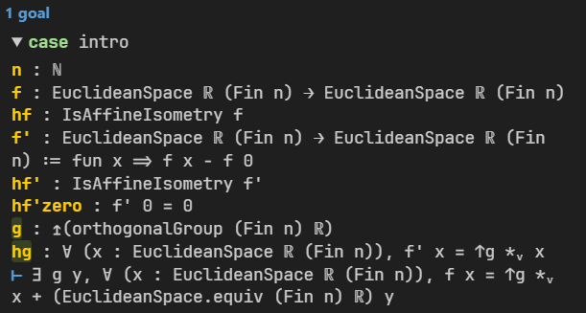
GOAL

Slide 50
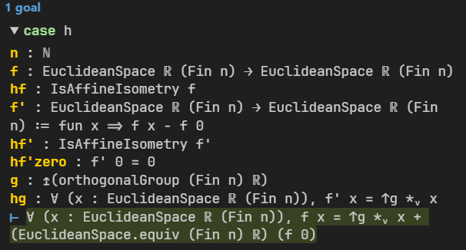
GOAL

Slide 51
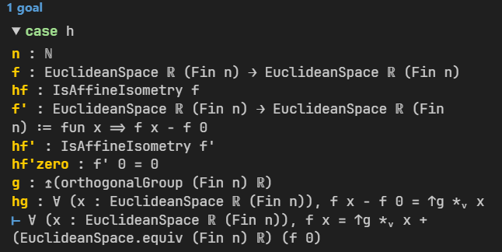
GOAL

Slide 52
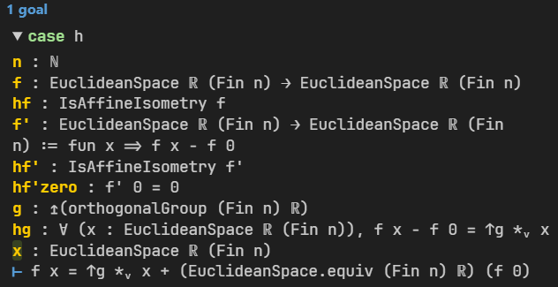
GOAL

Slide 53
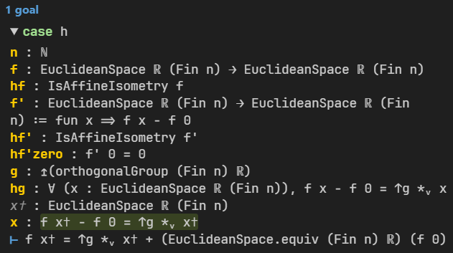
GOAL

Slide 54
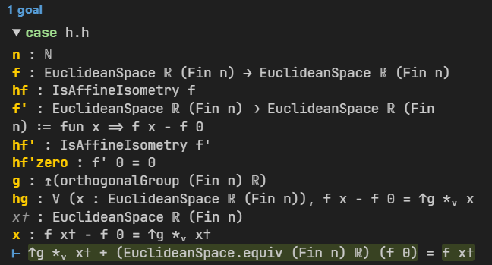
GOAL

Slide 55
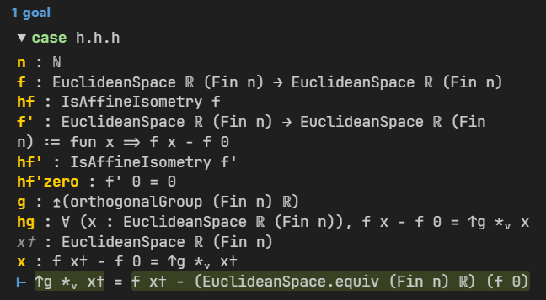
GOAL

Slide 56
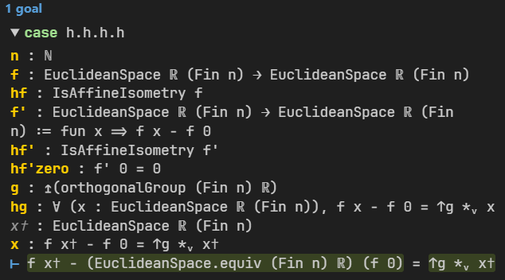
GOAL

Slide 57
GOAL

